Slide 1
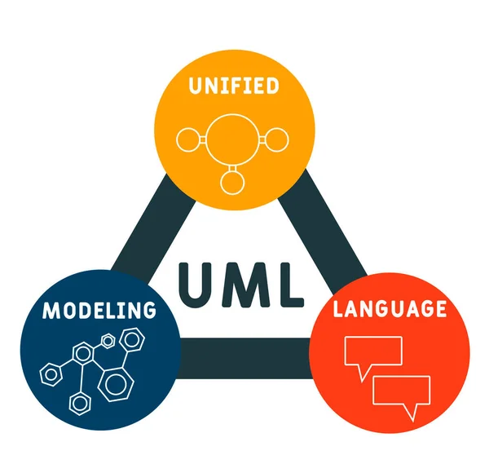
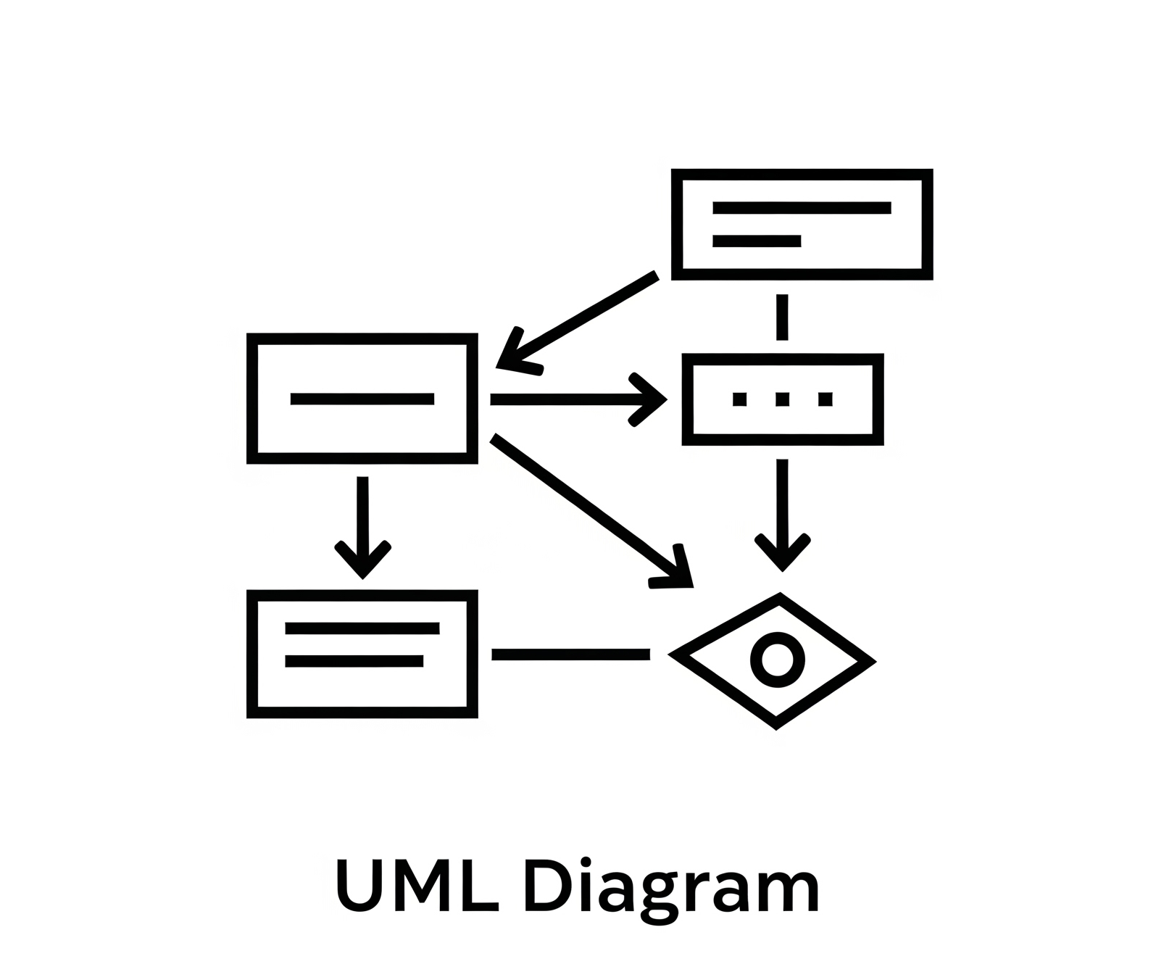
What is UML Diagram?
A UML diagram is a type of visual representation used in Unified Modeling Language (UML) to model the structure and behavior of a software system. UML diagrams help developers, designers, and stakeholders understand, design, and communicate complex software architecture clearly and systematically.

Slide 2
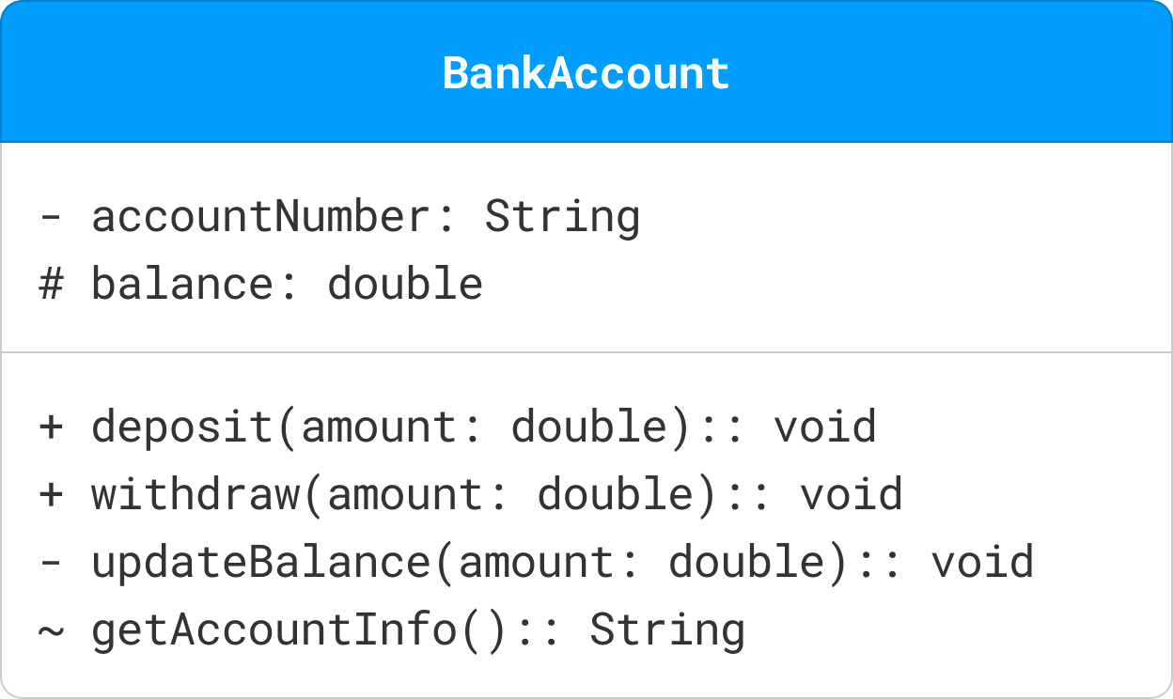
CLASS
A class is a blueprint or template that defines the properties and behavior of an object.
Represented as rectangles, classes are divided into three compartments:
Name (top compartment): The unique identifier of the class (e.g., Bank Account).
Attributes (middle compartment): The properties or data associated with the class (e.g., account Number, balance).
Operations (bottom compartment): The actions or methods that can be performed by objects of the class (e.g., deposit(), updateBalance()).
Visibility Markers: Visibility markers indicate the accessibility of attributes and methods within a class.
+ (Public): The attribute or method is accessible from any class.
- (Private): The attribute or method is only accessible within the same class.
# (Protected): The attribute or method is accessible within the same class and its subclasses.
~ (Package): The attribute or method is accessible within the same package.

Slide 3
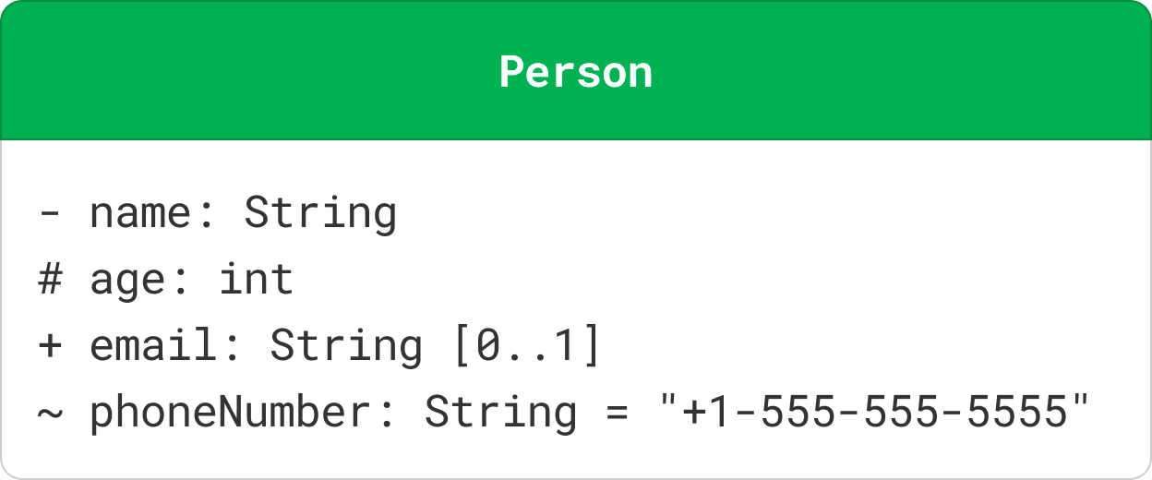
ATTRIBUTES
Attributes in a UML class diagram represent the properties or data fields of a class.
Attributes are typically written in the format:
visibility name: type [multiplicity] = defaultValue
Name: The name of the attribute.
Type: The data type of the attribute.
Multiplicity: (Optional) Indicates how many instances of the type are allowed.
Default Value: (Optional) The initial value of the attribute.

Slide 4
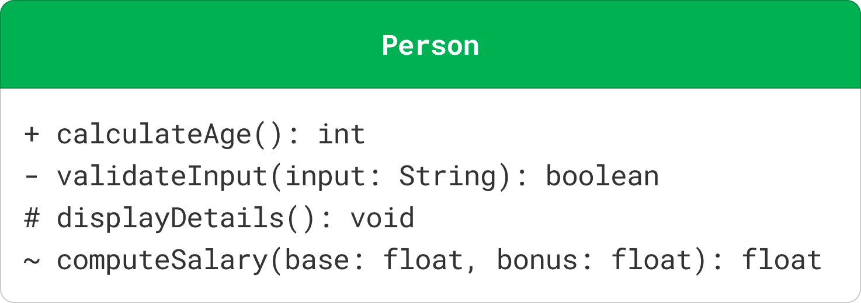
METHODS
Methods (or operations) in a UML class diagram represent the functions or behaviors that a class can perform.
Methods are typically written in the format:
visibility name(parameterList): returnType
Name: The name of the method.
Parameter List: A comma-separated list of parameters, each specified as name: type.
Return Type: The data type returned by the method.

Slide 5
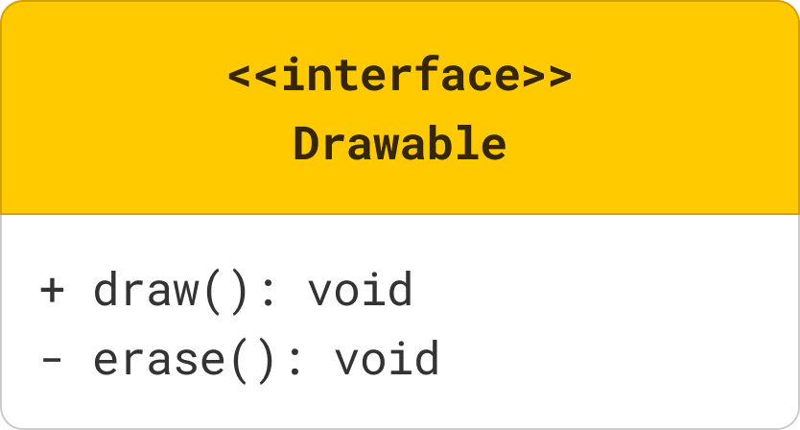
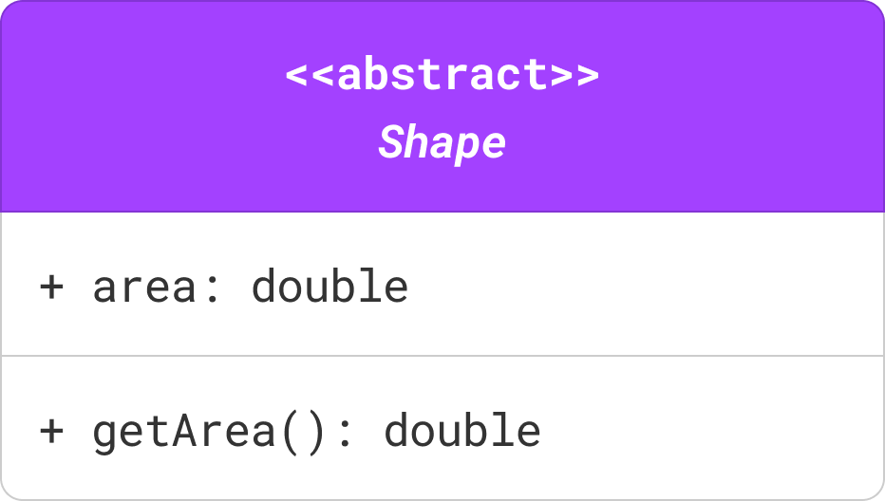
INTERFACES & ABSTRACT CLASS
An interface defines a contract for classes that implement it. It specifies a set of methods that the implementing classes must provide.
Interfaces are depicted as a class rectangle with the keyword «interface» above the interface name. Methods in interfaces are abstract by nature, so they are usually shown without any implementation details.
An abstract class is a class that cannot be instantiated (you can't create objects directly from it).
It serves as a blueprint for other classes (subclasses) that inherit from it.
An abstract class in UML is represented with the class name in italics and the keyword «abstract» above the class name. Abstract methods within the class are also typically shown in italics.

Slide 6
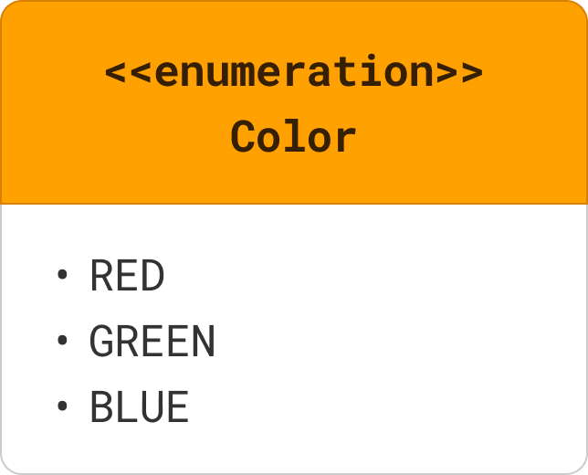
ENUMERATION
An enumeration is a data type that defines a set of named values (e.g., colors, days of the week).
Enumerations, or enums, are represented with the keyword «enumeration» above the enumeration name. The values of the enumeration are listed within the class box.

Slide 7
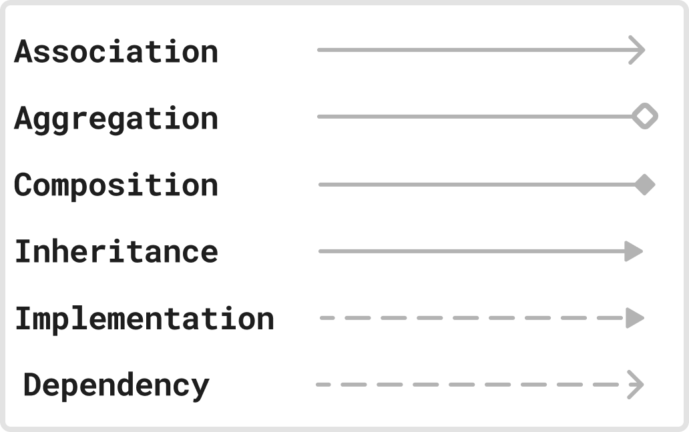
RELATIONSHIPS IN UML CLASS DIAGRAM
Association: Association represents a "uses-a" relationship between two classes where one class uses or interacts with the other.
Aggregation: Aggregation represents a "has-a" relationship where one class (the whole) contains another class (the part), but the contained class can exist independently.
Composition: Composition represents a strong "has-a" relationship where the part cannot exist without the whole. If the whole is destroyed, the parts are also destroyed.
Inheritance: Inheritance (or Generalization) represents an "is-a" relationship where one class (subclass) inherits the attributes and methods of another class (superclass).
Realization (Implementation): Realization or implementation represents a relationship between a class and an interface, where the class implements the methods declared in the interface.
Dependency: Dependency represents a "uses" relationship where a change in one class (the supplier) may affect the other class (the client).

Slide 8
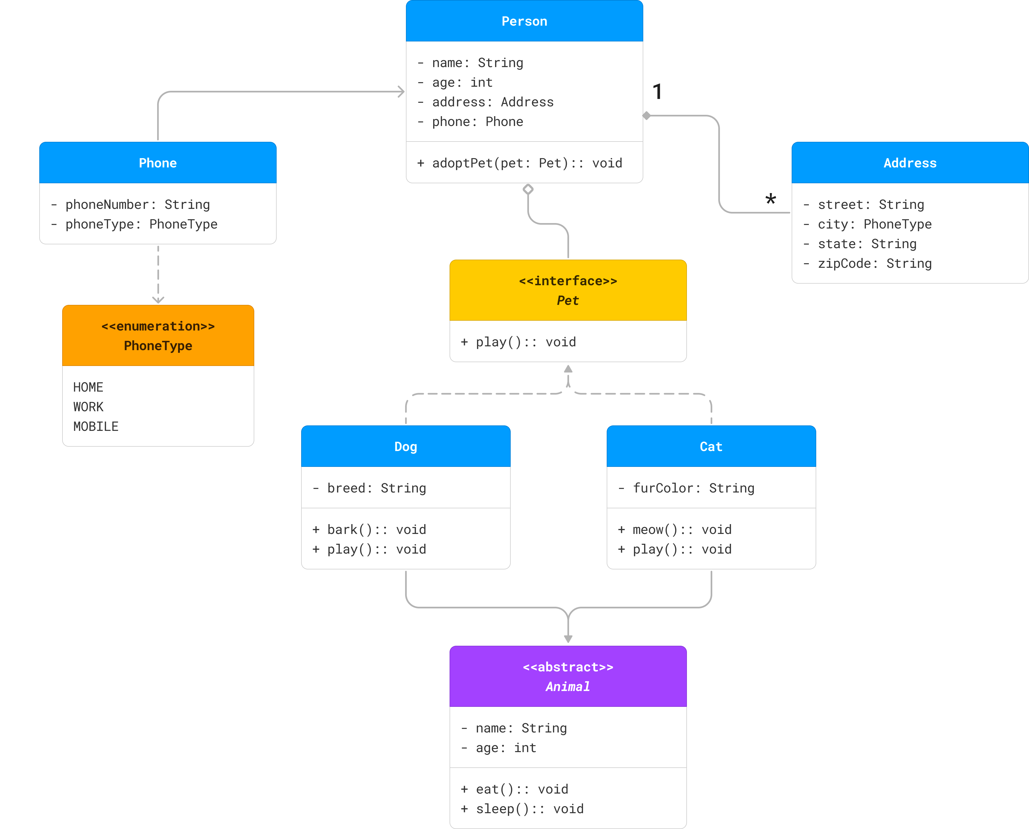
COMBINED EXAMPLE

